Slide 1
S&P 500 Financial Sector Optimization via Sharpe Ratio and Monte Carlo Simulation
Created by: Fatma Sardina, Monish Ravishankar, Arin Sood

Slide 2
Goals
Our goal with our simulation was to Calculate a Sharpe Ratio, Expected Returns, and Expected Volatility for each S&P Sector, and then run a Monte Carlo Simulation of 5000 iterations to calculate two portfolios, one prioritizing the Sharpe Ratio and the other focusing on low volatility.
Additionally, we wanted to implement a machine learning aspect to our simulation in order to enhance our results.

Slide 3
Process

Slide 4
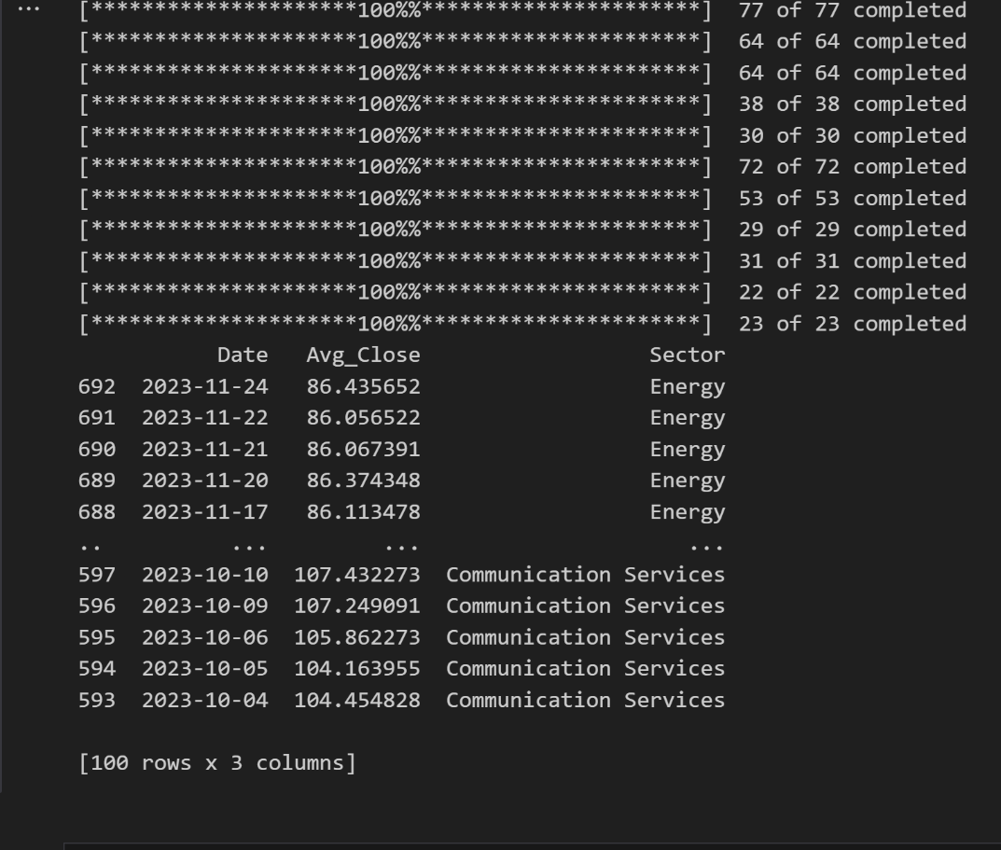
Data Collection
Our program first fetches a list of S&P 500 companies and their respective sectors using a Wikipedia List while also replacing tickers such as ‘BRK.B’ to ensure compatibility with Yahoo Finance. It then loops through each unique sector, retrieving adjusted closing prices for the last 90 days from Yahoo Finance, and then calculates Average Closing Price by using the mean of adjusted closing prices for all companies within the sector on that date.

Slide 5
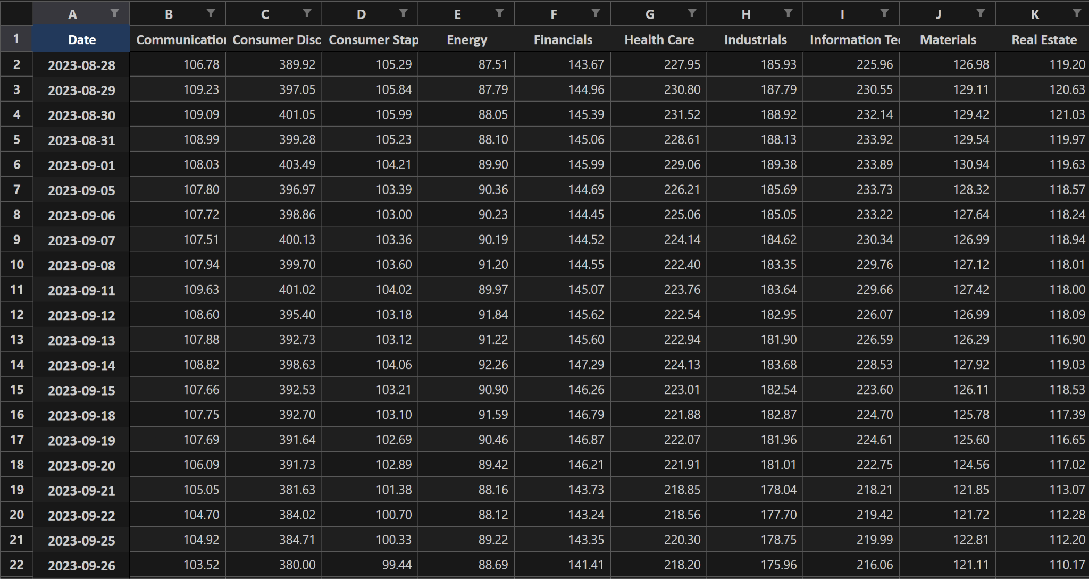
Data Formatting and Organization
Using the pandas library, our program organizes the obtained data into a DataFrame consisting of columns ‘Date’, ‘Sector’, and ‘Avg_Close’ which is then pivoted and stacked to display sectors as columns, dates as rows, and the average closing prices in a single column for each date. This dataframe is then saved as an Excel file, allowing us to broadly visualize the performance of companies in a particular sector and sector’s overall stock price movement in the past 90 days.

Slide 6
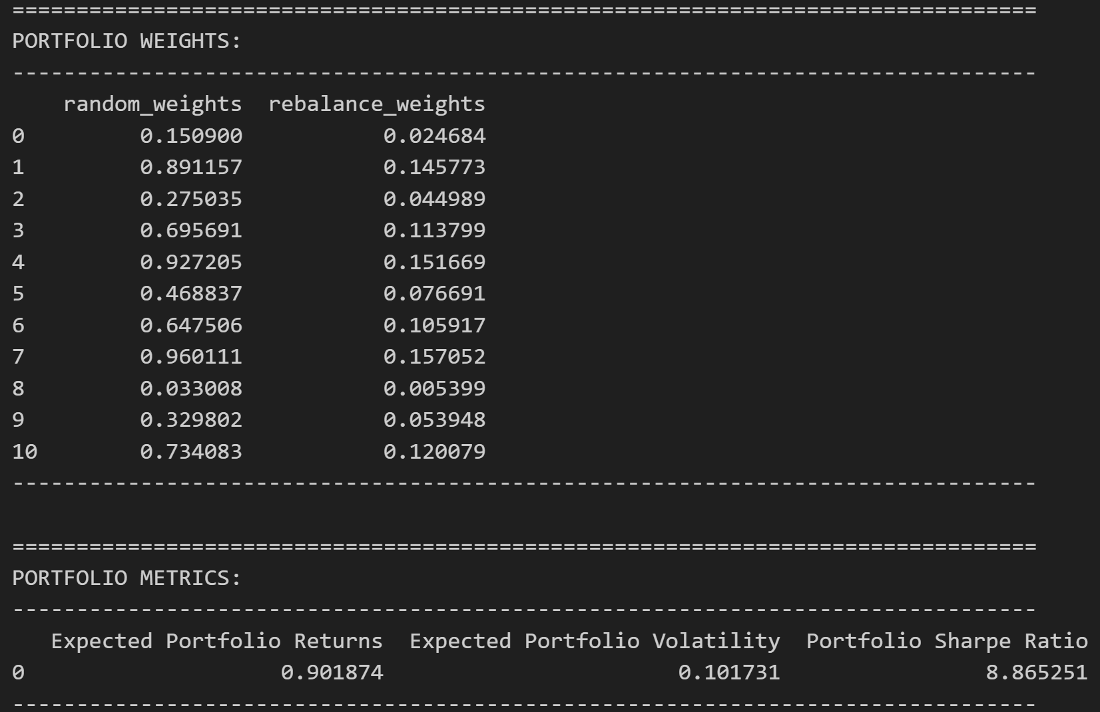
Calculating Sharpe Ratio
We first calculated the log of the returns using the pct_change() and log() functions and removing any log returns that are negative and put these values into a NumPy array. Then we put these results into another Excel file, and calculated the expected returns and volatility using the mean of the log_returns, the risk_free_rate, randomly generated weights, and multiplying it by 252, the standard length of a trading year.
By dividing the calculated expected returns and expected volatility, we get an example Sharpe Ratio.

Slide 7
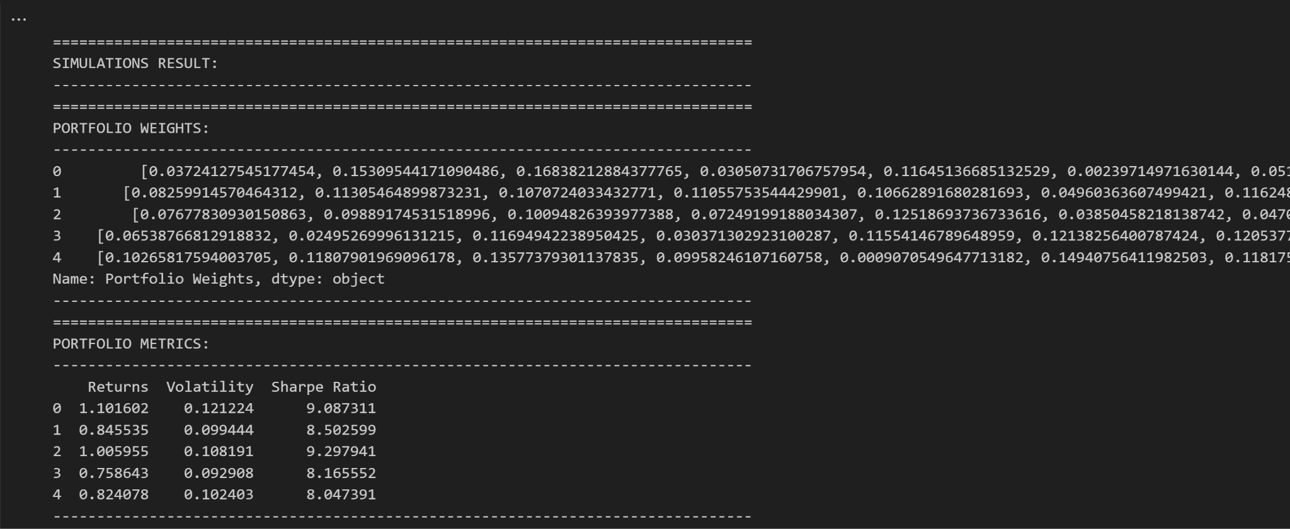
Monte Carlo Simulation
We then conduct a Monte Carlo simulation with 5000 iterations by making arrays to store, generated weights, calculated returns, calculated volatilities, and calculated Sharpe Ratios using the previously mentioned formulas. Following all of the calculations, we create a Simulations dataframe containing all of the arrays and properly organize it.
The picture shows the first few rows of Portfolio Weights and metrics in the Simulations dataframe.

Slide 8
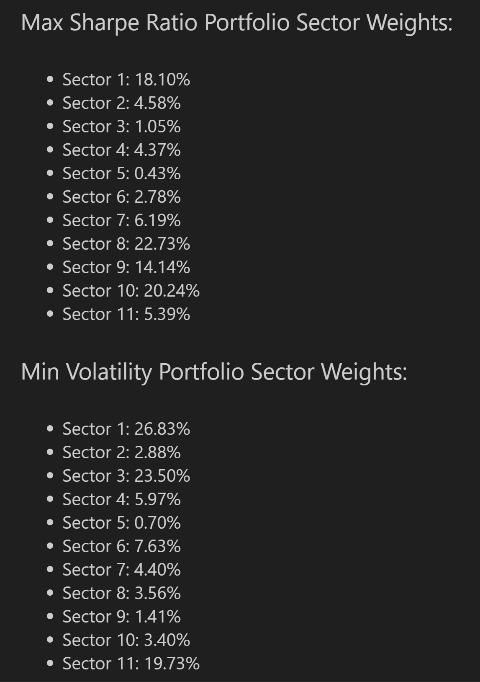
Portfolio Weightings
From the Simulation dataframe, we can find the portfolio weightings containing the maximum calculated Sharpe Ratio and the Minimum Volatility. In our simulated Monte Carlo run, our Max Sharpe Ratio Portfolio had a Sharpe Ratio of 7.43, an expected return of 61.93%, and a volatility risk of 8.34%, indicating a good balance between risk and return and the weights show a good diversification of assets.
Likewise, our Minimum Volatility Portfolio had an expected return of 11.62%, volatility risk of 6.1%, and a Sharpe Ratio of 1.90, with weightings tending to be more conservative but still diversified.

Slide 9
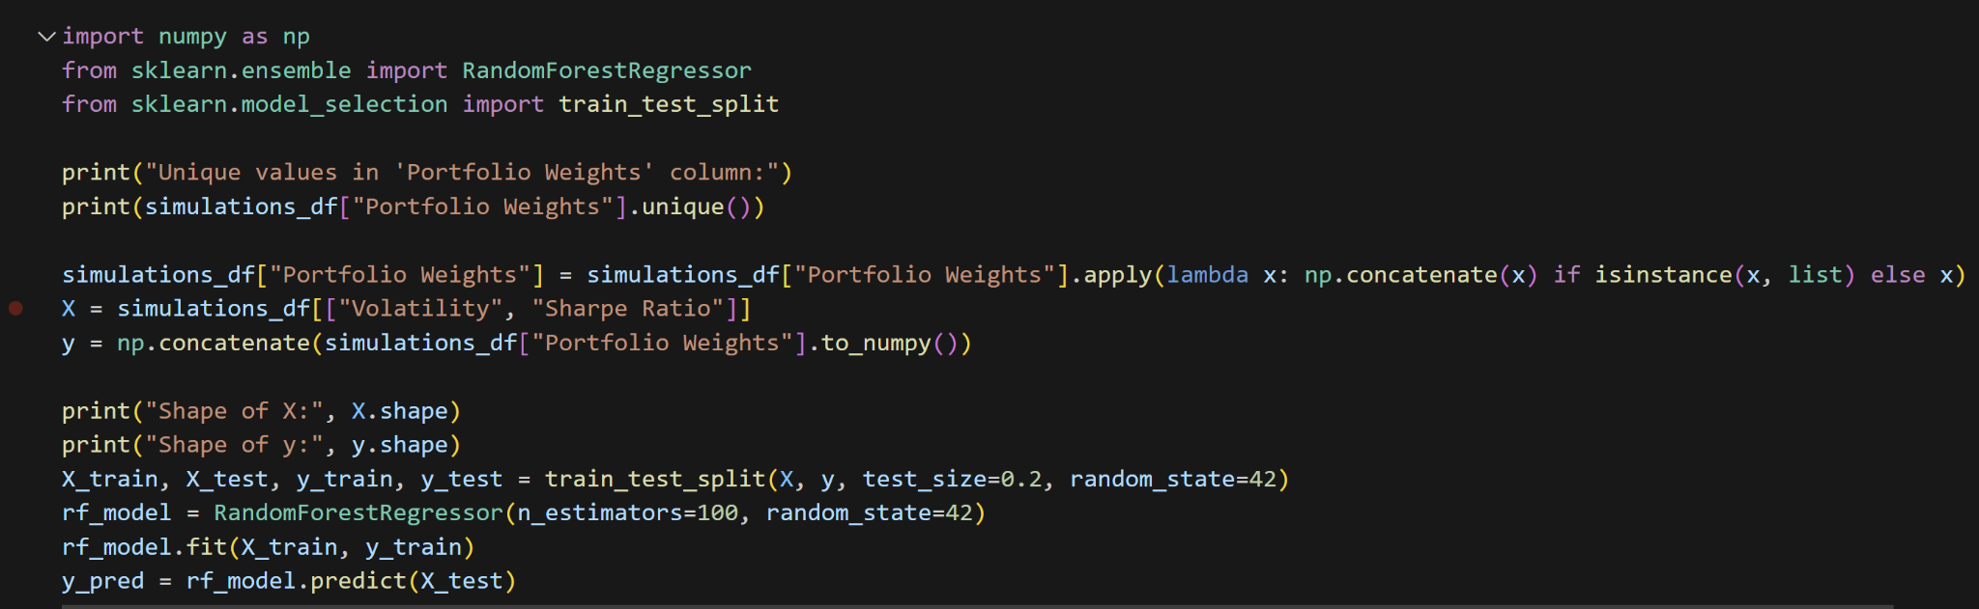
Machine Learning
We wanted to enhance our model using a machine learning model called the Random Forest Algorithm. This algorithm constructs decision trees during training and outputs the mean of prediction of individual trees. It builds these trees using a random subset of features, helping reduce overfitting. Our goal was to use the Random Forest Algorithm to capture and utilize historical patterns to improve the results of our simulation.

Slide 10
Thank You

